Slide 1
Employee Wellness Analysis
A Exploratory Data Analysis Project
Aditya Rajput

Slide 2
Introduction
Mental health has become a critical concern in modern workplaces
Work-related stress, anxiety, and burnout directly affect productivity and employee well-being
Many organizations lack data-driven understanding of mental health challenges
Exploratory Data Analysis (EDA) helps uncover hidden patterns and key influencing factors

Slide 3
Objectives
To analyze employee demographic patterns related to mental health
To understand how mental health affects work performance and productivity
To identify factors influencing mental health treatment-seeking behavior
To examine the impact of workplace conditions such as remote work and supervisor support
To derive actionable insights that can help organizations improve mental health policies

Slide 4
Dataset Overview
Key Columns (Fields)
Dataset Type: Employee Mental Health & Wellness Survey
Number of Records: ~1,000 employee responses
Number of Features: 25+ variables
Data Nature: Self-reported survey data
Key Attributes Included:
Demographics: Age, Gender, Country
Personal Factors: Family history of mental illness
Workplace Factors: Company size, Remote work, Supervisor support
Mental Health Indicators: Treatment status, Work interference

Slide 5
Data Preparation
Removed unrealistic and invalid age values to maintain real-world consistency
Standardized categorical variables such as gender to ensure uniform representation
Handled missing values in survey responses to avoid biased analysis
Normalized column names for consistency and easier analysis
Grouped similar categorical responses to improve clarity in visualizations

Slide 6
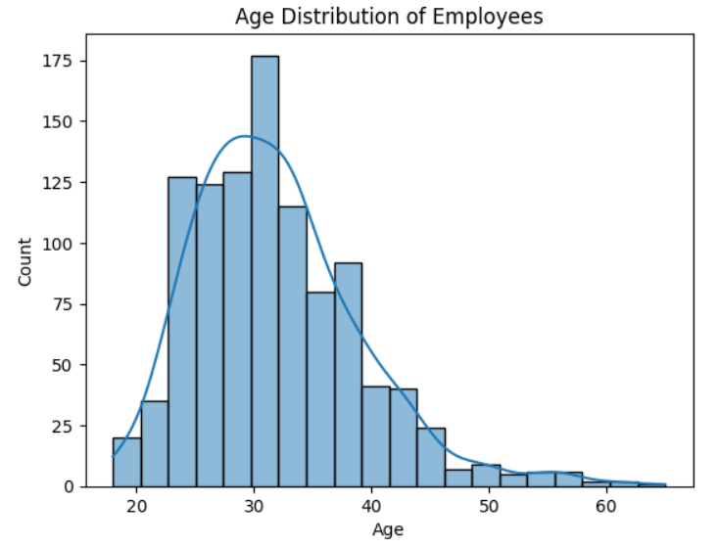
1. Age Distribution
Visualization Type :Histogram with Kernel Density Estimate (KDE)
Observations:
Most employes fall between 25 and 40 years, with a peak in the early 30s.
Employee count decreases beyond 40, forming a right-skewed distribution.
The KDE curve follows the histogram closely, indicating a consistent age pattern.
Insights :
The workforce is mainly early to mid-career professionals.
Mental health programs should focus more on younger employees, who form the majority.
Age distribution provides useful context for analyzing treatment and work-related stress.

Slide 7
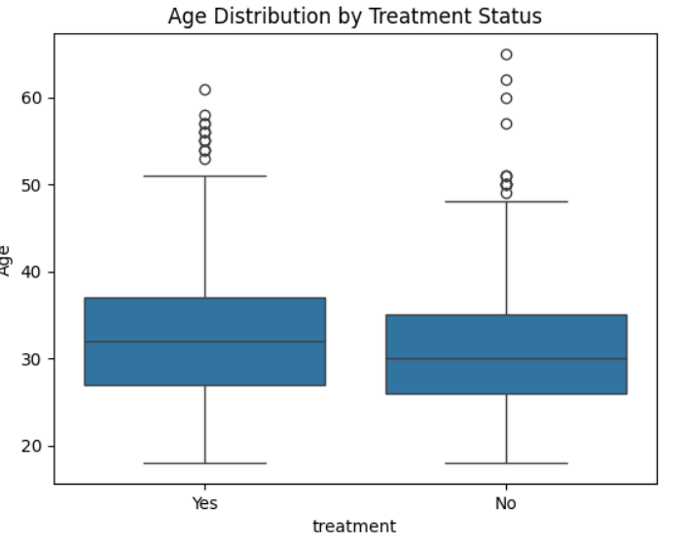
2. Age Dsitribution by Treatment
Visualization Type :Box Plot (Box-and-Whisker Plot)
Observations
Employees who have sought treatment show a slightly higher median age.
Both treatment groups have a similar age range, indicating mental health concerns across ages.
Older age values are more visible in the treatment group.
Insights
Older employees are more likely to seek mental health treatment, possibly due to higher awareness.
Younger employees may be less open to seeking help, despite experiencing stress.
This highlights the need for targeted awareness programs for early-career professionals.

Slide 8
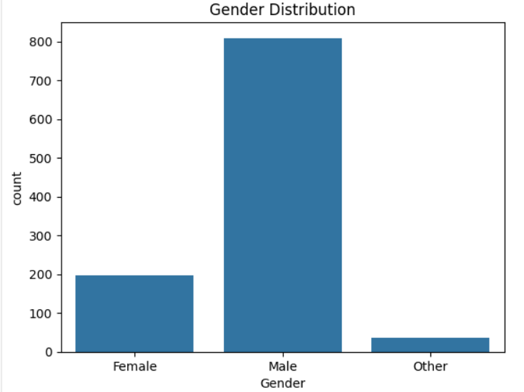
3. Gender Distribution
Visualization Type :Box Plot (Box-and-Whisker Plot)
Observations
Employees who have sought treatment show a slightly higher median age.
Both treatment groups have a similar age range, indicating mental health concerns across ages.
Older age values are more visible in the treatment group.
Insights
Older employees are more likely to seek mental health treatment, possibly due to higher awareness.
Younger employees may be less open to seeking help, despite experiencing stress.
This highlights the need for targeted awareness programs for early-career professionals.

Slide 9
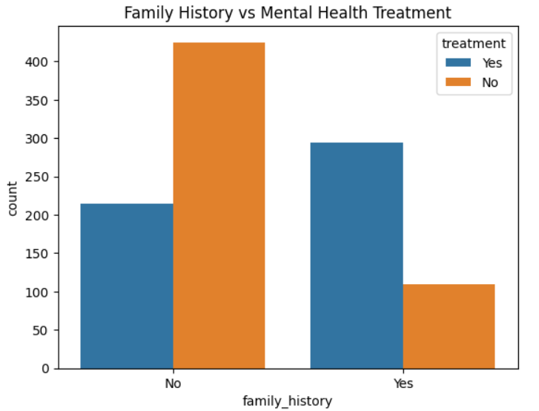
4. Family History vs Mental Health Treatment
Visualization Type : Grouped Bar Chart (Count Plot)
Observations
Employees with a family history of mental illness show a higher count of individuals seeking treatment.
Employees without a family history mostly fall into the non-treatment category.
The contrast between treatment and non-treatment is much stronger for those with family history.
Insights
Family history is a strong influencing factor in seeking mental health treatment.
Personal exposure increases awareness and acceptance of mental health support.
Organizations should promote mental health resources even for employees without prior family exposure.

Slide 10
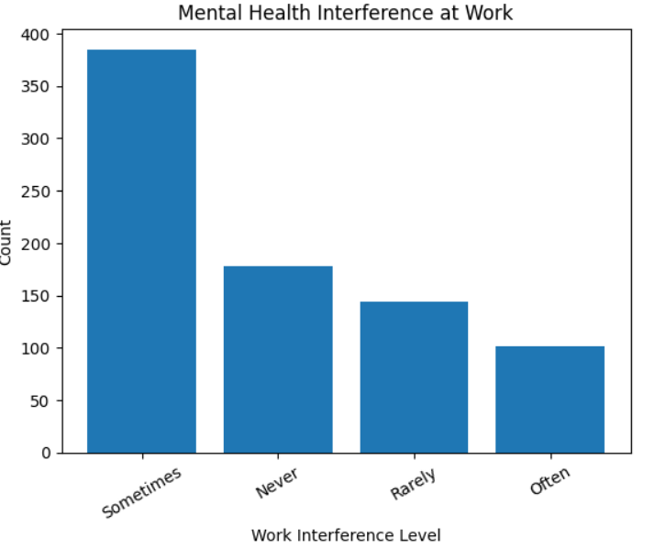
5. Mental Health Inteference at Work
Visualization Type : Bar Chart
Observations
The majority of employees report that mental health sometimes interferes with their work.
A noticeable number of employees report never experiencing interference.
Fewer employees report often experiencing interference, though it is still significant.
Insights
Mental health issues are intermittent but widespread, affecting productivity at various levels.
Even occasional interference can impact overall work performance and efficiency.
Organizations should address mental health proactively, not only for severe cases but also for moderate, recurring issues.

Slide 11
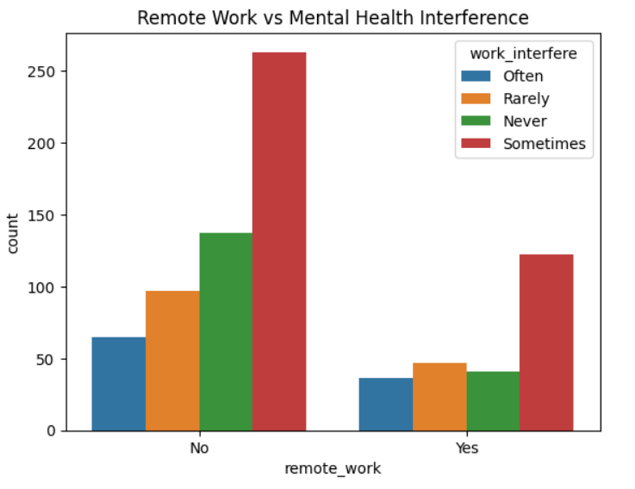
6. Remote Work vs Mental Health Interference
Visualization Type :Grouped Bar Chart
Observations
Employees who do not work remotely report higher counts of mental health interference across all categories.
The “sometimes” interference category is the most common for both remote and non-remote employees.
Employees working remotely show lower counts of frequent (“often”) interference.
Insights
Remote work appears to reduce the frequency of mental health interference, possibly due to increased flexibility.
Work-from-home or hybrid models may help employees better manage stress and mental health.
Flexible work arrangements can be an effective strategy for improving employee well-being.

Slide 12
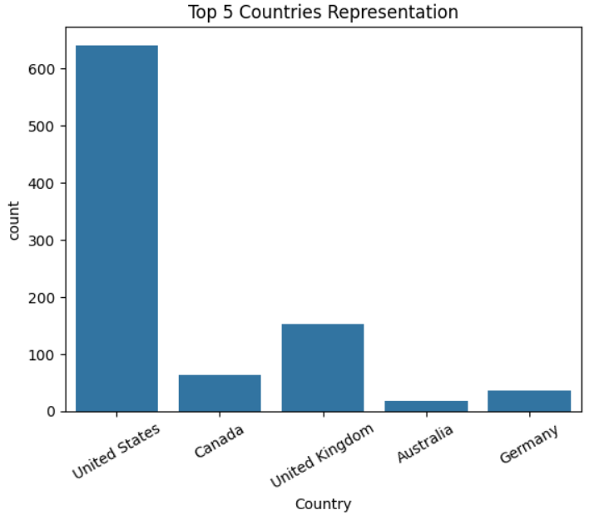
7. Remote Work vs Mental Health Interference
Visualization Type :Bar Chart
Observations
The United States has the highest number of employee responses by a large margin.
The United Kingdom and Canada follow but with significantly fewer responses.
Germany and Australia have minimal representation compared to the top countries.
Insights
The dataset is heavily dominated by the United States, making it largely US-centric.
Cultural and workplace practices from other regions may be underrepresented.
Findings should be interpreted with caution when generalizing to a global workforce.

Slide 13
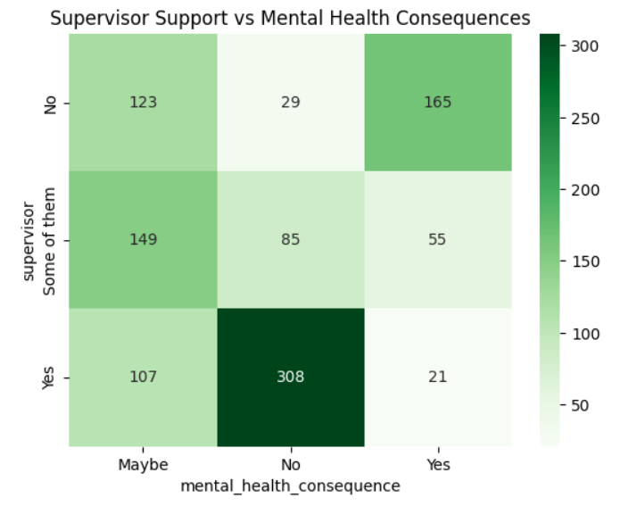
8. Remote Work vs Mental Health Interference
Visualization Type :Heatmap
Observations
Employees with supportive supervisors (Yes) mostly report no mental health consequences.
When supervisor support is absent (No), the count of reported negative consequences increases significantly.
Partial support (“Some of them”) shows mixed outcomes, indicating inconsistency in employee experience.
Insights
Strong supervisor support reduces fear and negative consequences related to mental health disclosure.
Manager behavior plays a critical role in creating a psychologically safe work environment.
Training supervisors to handle mental health concerns can significantly improve employee well-being.

Slide 14
Key Insights Summary
The workforce is primarily composed of early to mid-career professionals, with most employees aged between 25 and 40 years.
Employees who seek mental health treatment tend to be slightly older, indicating increased awareness with experience.
The dataset is male-dominated, which may influence overall mental health trends and reporting behavior.
A family history of mental illness strongly increases the likelihood of seeking treatment.
Mental health issues frequently interfere with work, even if not on a constant basis.
Remote work appears to reduce the frequency of mental health interference.
Supportive supervisors significantly lower negative consequences related to mental health disclosure.
The dataset is largely US-centric, so findings should be generalized with caution.

Slide 15
Conclusion
Mental health concerns commonly affect early and mid-career employees and impact work performance.
Factors like family history, supervisor support, and remote work strongly influence mental well-being.
Supportive leadership and flexible work policies help reduce mental health-related challenges.
Data-driven insights can guide organizations in improving workplace mental health support.

Slide 16
Thank You

